Slide 1











The kind of question I might ask you during our 1-on-1 regarding carbonate reactions
When calcium carbonate (chalk) at the sea floor dissolves in the water …
it amplifies ocean acidification
it counteracts ocean acidification
it has no effect on the ocean’s acidity
In nature, this process takes place …
quickly on a human time scale (~seconds)
slowly on a human time scale (centuries or more)
Air
$$CO_{2}$$
$$H_{2}O$$
$$H_{2}O$$
Oceans
$H_{2}CO_{3}$
$$H^{+}$$
$$H^{+}$$
$$HCO_{3}^{−}$$
$${Ca}^{2+}$$
$$CO_{3}^{2−}$$
Sea floor
$$CaCO_{3}$$
$$CaCO_{3}^{}$$

Slide 2
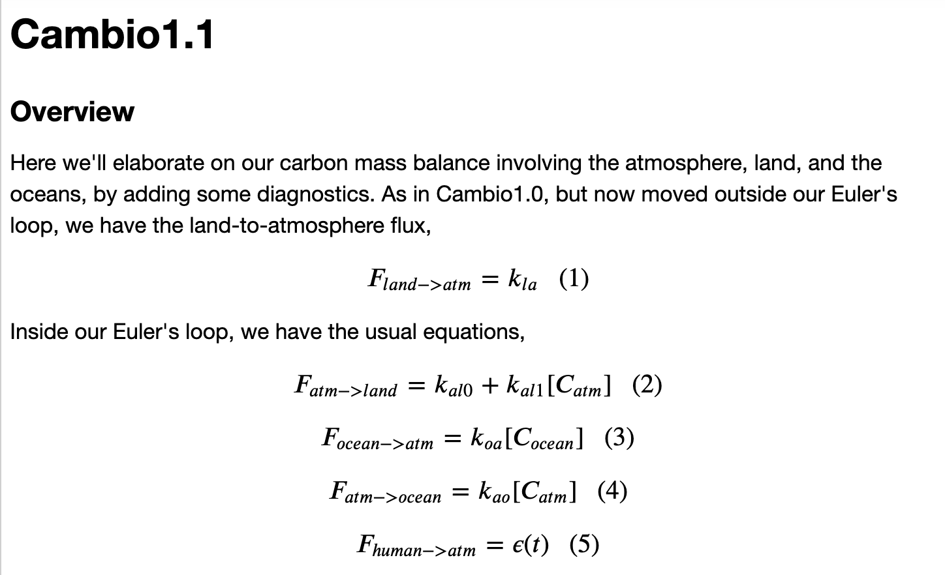
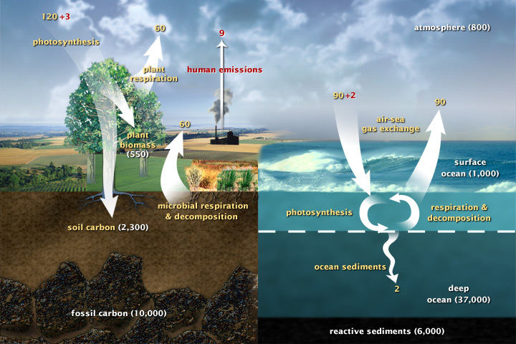
Week 8 - Algorithms underlying a mass balance model

Slide 3

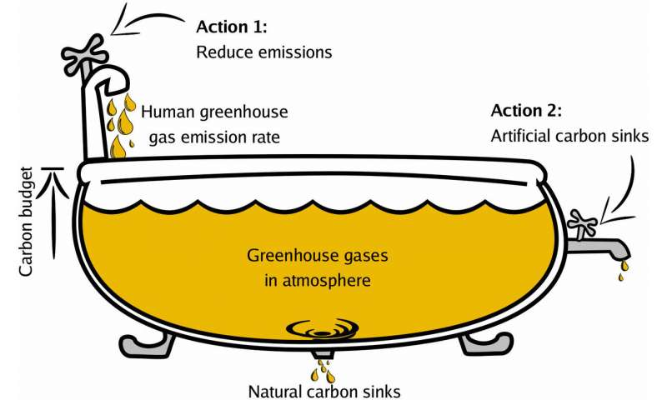
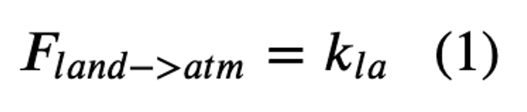
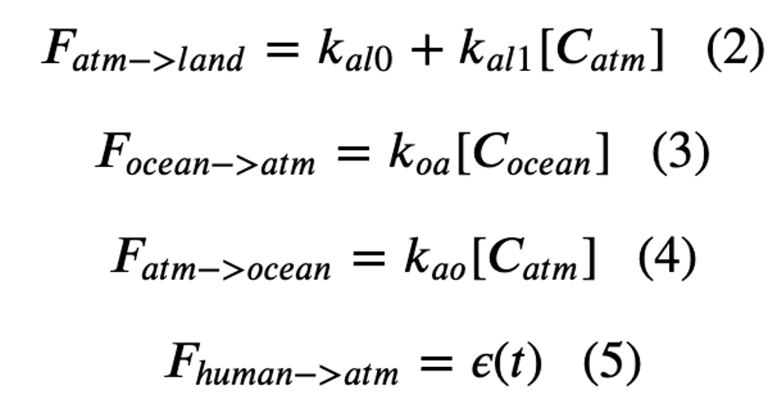
Week 8 – The Cambio model

Slide 4
Week 8 – The Cambio model – sources

Slide 5
Week 8 – The Cambio model – sources

Slide 6
Week 8 – The Cambio model – sinks

Slide 7
Week 8 – The Cambio model – sources and sinks

Slide 8
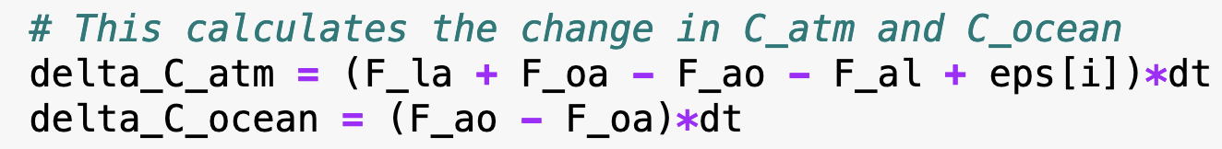
Week 8 – The Cambio model – sources and sinks and code

Slide 9
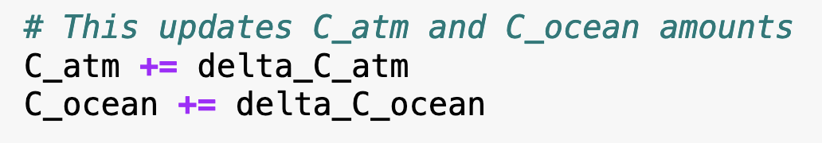
Week 8 – The Cambio model – sources and sinks and code

Slide 10
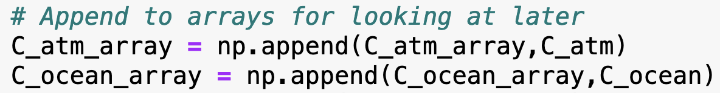
Week 8 – The Cambio model – sources and sinks and code

Slide 11
Week 8 - Diagnostics
The slope of the orange line is the climate sensitivity as the climate has responded in the last 150 years.

Slide 12

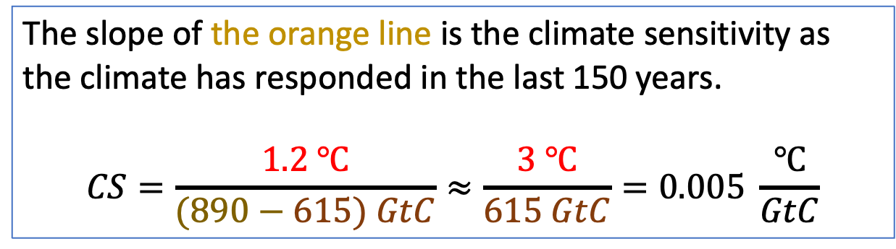

Week 8 - Diagnostics
The slope of the orange line is the climate sensitivity as the climate has responded in the last 150 years.
$$CS=\frac{1.2 ℃}{(890−615) GtC}≈\frac{3 ℃}{615 GtC}=0.005 \frac{℃}{GtC}$$
1.2 degrees warming
What models like EzGCM are predicting
$$615 GtC$$
$$890 GtC$$

Slide 13
Week 8 - Diagnostics
The slope of the orange line is the climate sensitivity as the climate has responded in the last 150 years.
$$CS=\frac{1.2 ℃}{(890−615) GtC}≈\frac{3 ℃}{615 GtC}=0.005 \frac{℃}{GtC}$$
1.2 degrees warming
What models like EzGCM are predicting
$$615 GtC$$
$$890 GtC$$

Slide 14
Week 8 - Diagnostics
The Blue line shows the climate sensitivity as the climate has responded to Milankovich wobbling over the last million years. It incorporates feedbacks that work over a longer time scale.

Slide 15
Week 8 - Diagnostics
The Blue line shows the climate sensitivity as the climate has responded to Milankovich wobbling over the last million years. It incorporates feedbacks that work over a longer time scale.
=> our use of the orange line is a “short-time-scale” estimate (i.e., the real climate will eventually shift toward the blue line.)

Slide 16
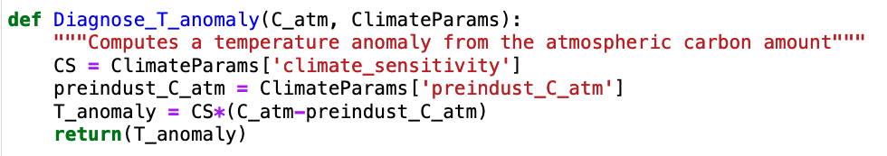
Week 8 - Diagnostics
The Blue line shows the climate sensitivity as the climate has responded to Milankovich wobbling over the last million years. It incorporates feedbacks that work over a longer time scale.
=> our use of the orange line is a “short-time-scale” estimate (i.e., the real climate will eventually shift toward the blue line.)

Slide 17
Week 9 – Cambio2.0, beginning to incorporate tipping points
This is over the last million years
T (relative to 1960)
CO2 driving + ice-albedo amplification?
This is over the last 150 years
Courtesy Penny Rowe
Courtesy Penny Rowe

